Slide 1
Computer Networks Transmission Media (Guided)
Amitangshu Pal
Computer Science and Engineering
IIT Kanpur

Slide 2
Guided Transmission Medium
Guided medium:
Twisted pair, coaxial cable, optical fiber
Twisted pair and coaxial cable: Use metallic (copper) conductors that accept and transport signals in the form of electric current
Optical fiber is a cable that accepts and transports signals in the form of light
Notes:
Let me first give a brief introduction of WOBAN architecture and the motivation of using WOBAN as an access technology. There are two main types of popular access networks. 1. Optical access networks where from CO optical fibers are pulled to ONUs located at every homes, premises or offices, which basically work as gateways for Internet access to the users. The popular access technology of this access networks is PON. The advantage of this access is that it provides high bandwidth and fast Internet service. The limitation is that it needs fiber to penetrate in each and every premises which make this scheme very costly. Also there is a limitation of maximum fiber length.
Another popular access networks is wireless access. Popular technology of this type are WiFi and WiMAX. The advantage of these access technology is that this is flexible and cost effective scheme. But the limitation is that when the hop of hops increase a lot, real time multi-media traffic suffers a lot.
Let me first give a brief introduction of WOBAN architecture and the motivation of using WOBAN as an access technology. There are two main types of popular access networks. First is the optical access such as passive optical networks (PON), which provides fast Internet service because of high bandwidth. But it requires fiber to be penetrated from central office to all residential complex, offices and premises which make the scheme highly costly. Another popular access technology is wireless access, which is flexible and cost-efficient, but does not function well when the number of hops increases.

Slide 3
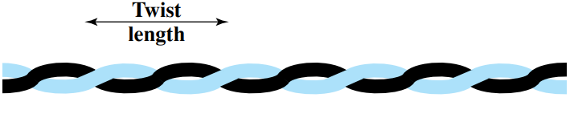
Twisted pair cable
Twisted pair cable:
A twisted pair consists of two conductors (normally copper), each with its own plastic insulation, twisted together
Two wires carry signals of opposite polarities
The receiver uses the difference between the two
Notes:
Let me first give a brief introduction of WOBAN architecture and the motivation of using WOBAN as an access technology. There are two main types of popular access networks. 1. Optical access networks where from CO optical fibers are pulled to ONUs located at every homes, premises or offices, which basically work as gateways for Internet access to the users. The popular access technology of this access networks is PON. The advantage of this access is that it provides high bandwidth and fast Internet service. The limitation is that it needs fiber to penetrate in each and every premises which make this scheme very costly. Also there is a limitation of maximum fiber length.
Another popular access networks is wireless access. Popular technology of this type are WiFi and WiMAX. The advantage of these access technology is that this is flexible and cost effective scheme. But the limitation is that when the hop of hops increase a lot, real time multi-media traffic suffers a lot.
Let me first give a brief introduction of WOBAN architecture and the motivation of using WOBAN as an access technology. There are two main types of popular access networks. First is the optical access such as passive optical networks (PON), which provides fast Internet service because of high bandwidth. But it requires fiber to be penetrated from central office to all residential complex, offices and premises which make the scheme highly costly. Another popular access technology is wireless access, which is flexible and cost-efficient, but does not function well when the number of hops increases.

Slide 4
Twisted pair cable
Twisted pair cable:
Twisting makes sure that both wires are equally affected by external influences (noise or crosstalk)
Converse is also true
Notes:
Let me first give a brief introduction of WOBAN architecture and the motivation of using WOBAN as an access technology. There are two main types of popular access networks. 1. Optical access networks where from CO optical fibers are pulled to ONUs located at every homes, premises or offices, which basically work as gateways for Internet access to the users. The popular access technology of this access networks is PON. The advantage of this access is that it provides high bandwidth and fast Internet service. The limitation is that it needs fiber to penetrate in each and every premises which make this scheme very costly. Also there is a limitation of maximum fiber length.
Another popular access networks is wireless access. Popular technology of this type are WiFi and WiMAX. The advantage of these access technology is that this is flexible and cost effective scheme. But the limitation is that when the hop of hops increase a lot, real time multi-media traffic suffers a lot.
Let me first give a brief introduction of WOBAN architecture and the motivation of using WOBAN as an access technology. There are two main types of popular access networks. First is the optical access such as passive optical networks (PON), which provides fast Internet service because of high bandwidth. But it requires fiber to be penetrated from central office to all residential complex, offices and premises which make the scheme highly costly. Another popular access technology is wireless access, which is flexible and cost-efficient, but does not function well when the number of hops increases.

Slide 5
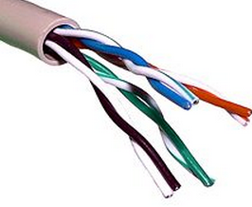
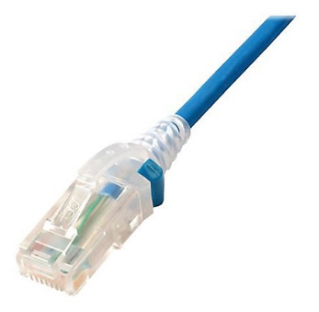
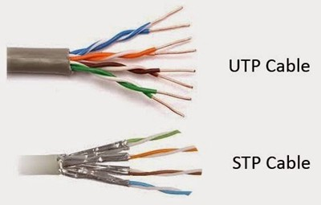
Twisted pair cable
Twisted pair cable:
Unshielded Twisted pair
ordinary telephone wire
cheapest
easiest to install
suffers from external electromagnetic interference
Shielded Twisted pair:
Has a metal foil or braided mesh covering that encases each pair of insulated conductors
Improves the quality of cable by preventing the penetration of noise or crosstalk
Bulkier and more expensive
Used in telephone lines and LANs
Src:https://commons.wikimedia.org/wiki/File:UTP_cable.jpg
Src: https://medium.com/@bilby_yang/comparison-between-utp-and-stp-27f7ac1d61aa
Notes:
Let me first give a brief introduction of WOBAN architecture and the motivation of using WOBAN as an access technology. There are two main types of popular access networks. 1. Optical access networks where from CO optical fibers are pulled to ONUs located at every homes, premises or offices, which basically work as gateways for Internet access to the users. The popular access technology of this access networks is PON. The advantage of this access is that it provides high bandwidth and fast Internet service. The limitation is that it needs fiber to penetrate in each and every premises which make this scheme very costly. Also there is a limitation of maximum fiber length.
Another popular access networks is wireless access. Popular technology of this type are WiFi and WiMAX. The advantage of these access technology is that this is flexible and cost effective scheme. But the limitation is that when the hop of hops increase a lot, real time multi-media traffic suffers a lot.
Let me first give a brief introduction of WOBAN architecture and the motivation of using WOBAN as an access technology. There are two main types of popular access networks. First is the optical access such as passive optical networks (PON), which provides fast Internet service because of high bandwidth. But it requires fiber to be penetrated from central office to all residential complex, offices and premises which make the scheme highly costly. Another popular access technology is wireless access, which is flexible and cost-efficient, but does not function well when the number of hops increases.

Slide 6
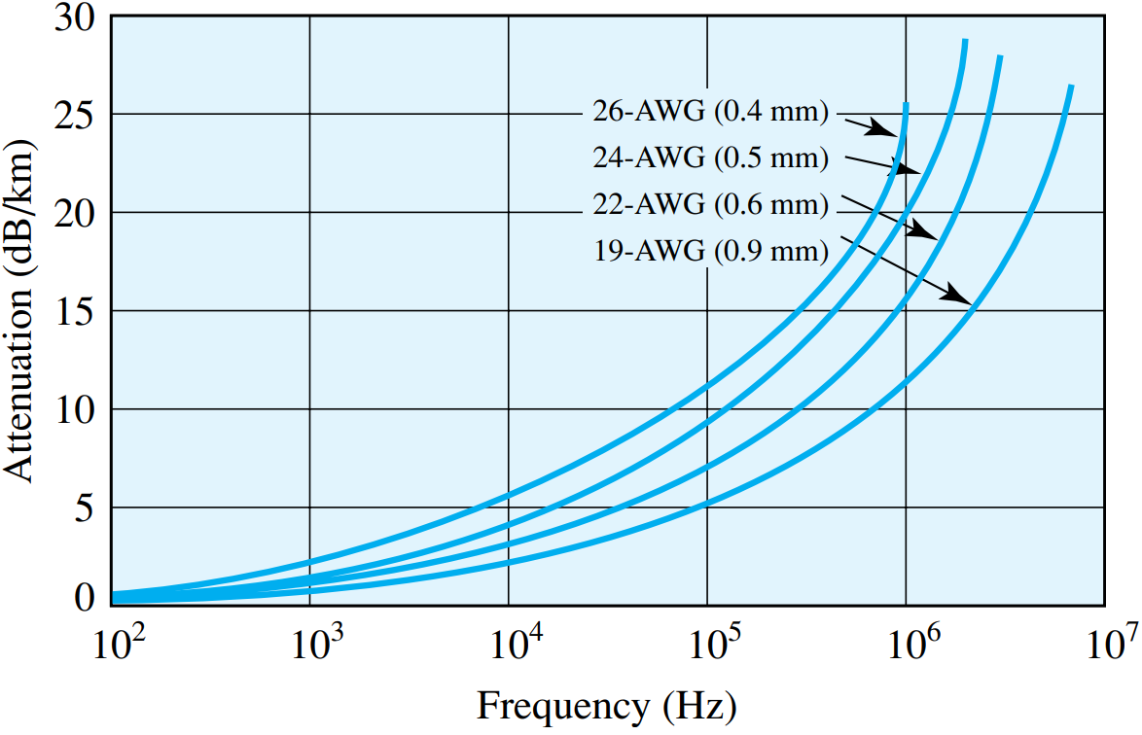
Twisted Pair Cable Performance
Notes:
In this discuss I am going to discuss a number of adaptive routing challenges in wireless multi-hop networks. The routing issues that I have addressed are tied with other distributed algorithms such as channel selection and power control. I have addressed these challenges in two domains of wireless networks, 1. WOBAN and 2. WSNs.
I will first talk about the basic architecture of WOBAN and describe the problem of routing and channel selection in this kind of architecture. We solve this problem in three phases. First we describe a quality aware routing for single gateway WOBAN. Then we extend this model for WOBAN with multiple gateways. Next we address the routing problem in WOBANs that are equipped with multiple wireless gateways and the wireless routers have multiple radio interfaces.
After that I will address the problem of energy aware routing in data collection WSNs where enhancing the network lifetime is the major concern. We propose two ways to reduce the energy consumption in WSNS 1. by using multiple channels that gives rise to joint routing and channel selection in WSNs and another is through power control.

Slide 7
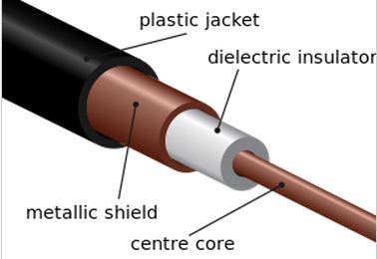
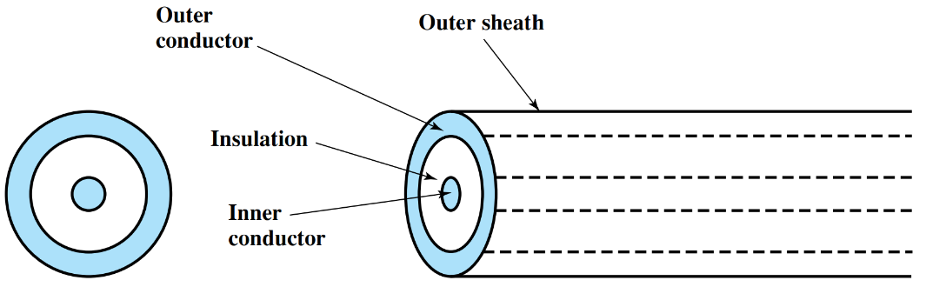
Coaxial Cable
Coaxial cable can be used over longer distances
Supports more stations on a shared line than twisted pair
Consists of a hollow outer cylindrical conductor that surrounds a single inner wire conductor
Used for TV distribution, long distance telephone transmission and LANs
Src:https://commons.wikimedia.org/wiki/File:Coaxial_cable_cutaway.svg
Notes:
In this discuss I am going to discuss a number of adaptive routing challenges in wireless multi-hop networks. The routing issues that I have addressed are tied with other distributed algorithms such as channel selection and power control. I have addressed these challenges in two domains of wireless networks, 1. WOBAN and 2. WSNs.
I will first talk about the basic architecture of WOBAN and describe the problem of routing and channel selection in this kind of architecture. We solve this problem in three phases. First we describe a quality aware routing for single gateway WOBAN. Then we extend this model for WOBAN with multiple gateways. Next we address the routing problem in WOBANs that are equipped with multiple wireless gateways and the wireless routers have multiple radio interfaces.
After that I will address the problem of energy aware routing in data collection WSNs where enhancing the network lifetime is the major concern. We propose two ways to reduce the energy consumption in WSNS 1. by using multiple channels that gives rise to joint routing and channel selection in WSNs and another is through power control.

Slide 8
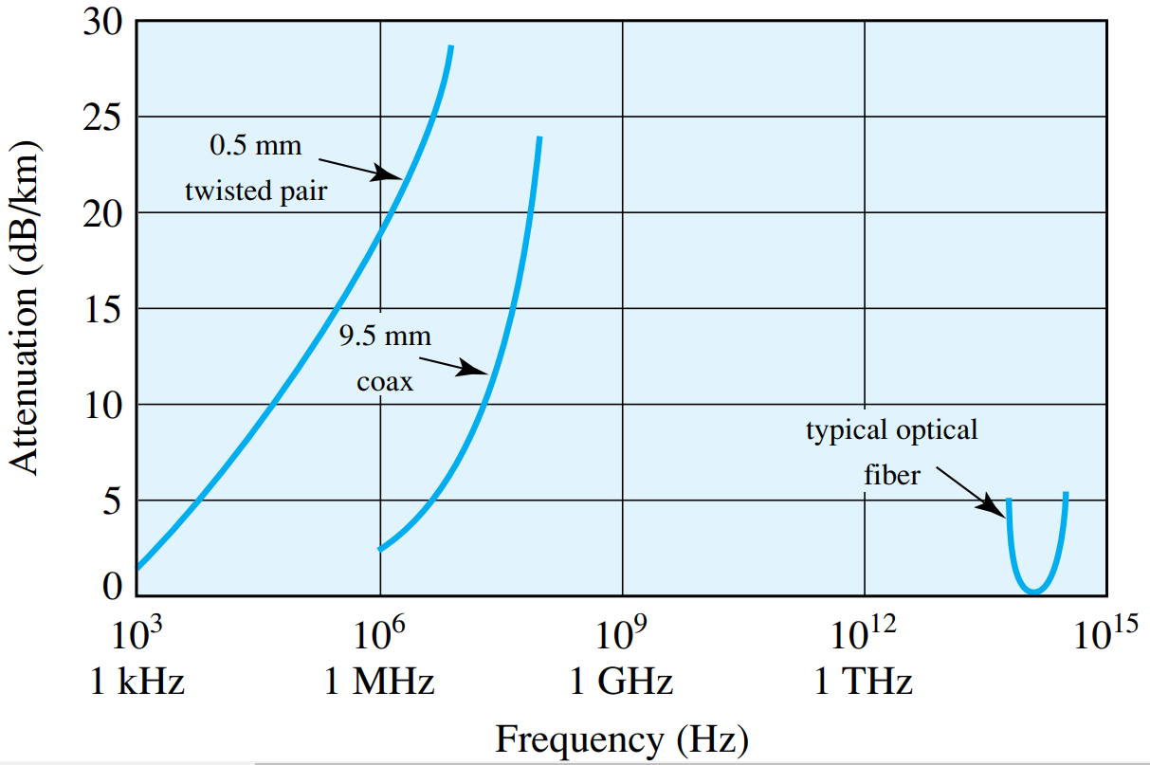
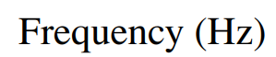
Coaxial Cable Performance
Notes:
In this discuss I am going to discuss a number of adaptive routing challenges in wireless multi-hop networks. The routing issues that I have addressed are tied with other distributed algorithms such as channel selection and power control. I have addressed these challenges in two domains of wireless networks, 1. WOBAN and 2. WSNs.
I will first talk about the basic architecture of WOBAN and describe the problem of routing and channel selection in this kind of architecture. We solve this problem in three phases. First we describe a quality aware routing for single gateway WOBAN. Then we extend this model for WOBAN with multiple gateways. Next we address the routing problem in WOBANs that are equipped with multiple wireless gateways and the wireless routers have multiple radio interfaces.
After that I will address the problem of energy aware routing in data collection WSNs where enhancing the network lifetime is the major concern. We propose two ways to reduce the energy consumption in WSNS 1. by using multiple channels that gives rise to joint routing and channel selection in WSNs and another is through power control.

Slide 9
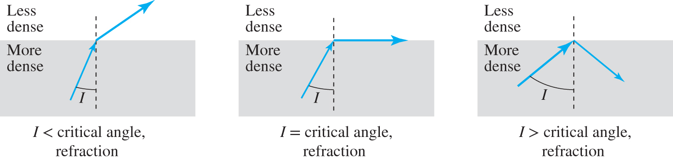
Optical Fiber
Uses total internal reflection to transmit light
When waves are refracted from a dense medium to a lighter medium the angle of refraction is greater than the angle of incidence
As the angle of incidence approaches a certain threshold (called the critical angle), the angle of refraction approaches 90° → the refracted ray becomes parallel to the boundary surface
As the angle of incidence increases beyond the critical angle, the conditions of refraction can no longer be satisfied, so there is no refracted ray, and the partial reflection becomes total
Notes:
In this discuss I am going to discuss a number of adaptive routing challenges in wireless multi-hop networks. The routing issues that I have addressed are tied with other distributed algorithms such as channel selection and power control. I have addressed these challenges in two domains of wireless networks, 1. WOBAN and 2. WSNs.
I will first talk about the basic architecture of WOBAN and describe the problem of routing and channel selection in this kind of architecture. We solve this problem in three phases. First we describe a quality aware routing for single gateway WOBAN. Then we extend this model for WOBAN with multiple gateways. Next we address the routing problem in WOBANs that are equipped with multiple wireless gateways and the wireless routers have multiple radio interfaces.
After that I will address the problem of energy aware routing in data collection WSNs where enhancing the network lifetime is the major concern. We propose two ways to reduce the energy consumption in WSNS 1. by using multiple channels that gives rise to joint routing and channel selection in WSNs and another is through power control.

Slide 10
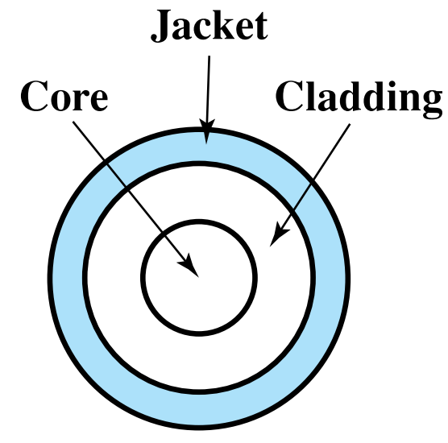
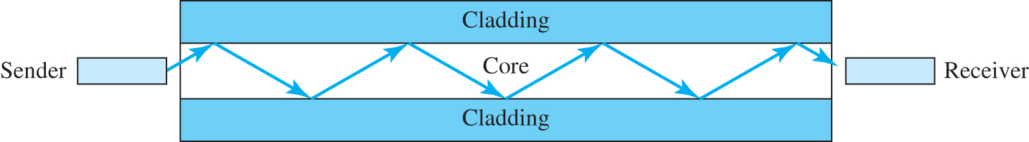
Optical Fiber
Optical fiber is a thin flexible medium capable of guiding an optical ray
Various glasses and plastics can be used to make optical fibers
Has a cylindrical shape with three sections
Core, cladding, jacket
Notes:
In this discuss I am going to discuss a number of adaptive routing challenges in wireless multi-hop networks. The routing issues that I have addressed are tied with other distributed algorithms such as channel selection and power control. I have addressed these challenges in two domains of wireless networks, 1. WOBAN and 2. WSNs.
I will first talk about the basic architecture of WOBAN and describe the problem of routing and channel selection in this kind of architecture. We solve this problem in three phases. First we describe a quality aware routing for single gateway WOBAN. Then we extend this model for WOBAN with multiple gateways. Next we address the routing problem in WOBANs that are equipped with multiple wireless gateways and the wireless routers have multiple radio interfaces.
After that I will address the problem of energy aware routing in data collection WSNs where enhancing the network lifetime is the major concern. We propose two ways to reduce the energy consumption in WSNS 1. by using multiple channels that gives rise to joint routing and channel selection in WSNs and another is through power control.

Slide 11
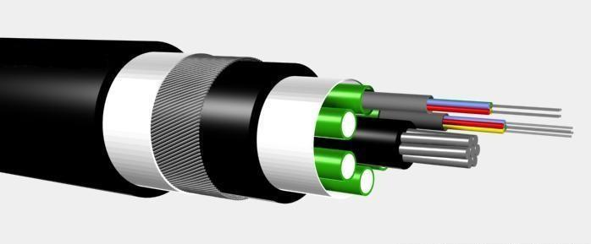
Optical Fiber
Light sources used:
Light Emitting Diode (LED)
Cheaper, operates over a greater temperature range, lasts longer
Injection Laser Diode (ILD)
More efficient, has greater data rates
Src:https://commons.wikimedia.org/wiki/File:Optical_fiber_cable.jpg
Notes:
In this discuss I am going to discuss a number of adaptive routing challenges in wireless multi-hop networks. The routing issues that I have addressed are tied with other distributed algorithms such as channel selection and power control. I have addressed these challenges in two domains of wireless networks, 1. WOBAN and 2. WSNs.
I will first talk about the basic architecture of WOBAN and describe the problem of routing and channel selection in this kind of architecture. We solve this problem in three phases. First we describe a quality aware routing for single gateway WOBAN. Then we extend this model for WOBAN with multiple gateways. Next we address the routing problem in WOBANs that are equipped with multiple wireless gateways and the wireless routers have multiple radio interfaces.
After that I will address the problem of energy aware routing in data collection WSNs where enhancing the network lifetime is the major concern. We propose two ways to reduce the energy consumption in WSNS 1. by using multiple channels that gives rise to joint routing and channel selection in WSNs and another is through power control.

Slide 12
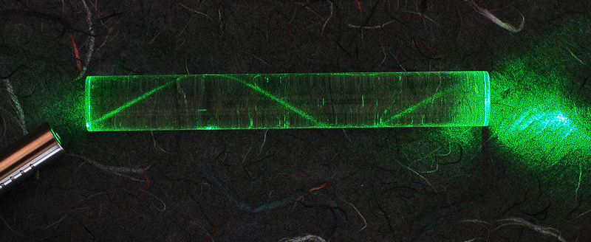
Optical Fiber
Src: https://commons.wikimedia.org/wiki/File:Laser_in_fibre.jpg
Notes:
In this discuss I am going to discuss a number of adaptive routing challenges in wireless multi-hop networks. The routing issues that I have addressed are tied with other distributed algorithms such as channel selection and power control. I have addressed these challenges in two domains of wireless networks, 1. WOBAN and 2. WSNs.
I will first talk about the basic architecture of WOBAN and describe the problem of routing and channel selection in this kind of architecture. We solve this problem in three phases. First we describe a quality aware routing for single gateway WOBAN. Then we extend this model for WOBAN with multiple gateways. Next we address the routing problem in WOBANs that are equipped with multiple wireless gateways and the wireless routers have multiple radio interfaces.
After that I will address the problem of energy aware routing in data collection WSNs where enhancing the network lifetime is the major concern. We propose two ways to reduce the energy consumption in WSNS 1. by using multiple channels that gives rise to joint routing and channel selection in WSNs and another is through power control.

Slide 13
Optical Fiber
Mode
Multi mode
Single mode
Graded index
Step index
Notes:
In this discuss I am going to discuss a number of adaptive routing challenges in wireless multi-hop networks. The routing issues that I have addressed are tied with other distributed algorithms such as channel selection and power control. I have addressed these challenges in two domains of wireless networks, 1. WOBAN and 2. WSNs.
I will first talk about the basic architecture of WOBAN and describe the problem of routing and channel selection in this kind of architecture. We solve this problem in three phases. First we describe a quality aware routing for single gateway WOBAN. Then we extend this model for WOBAN with multiple gateways. Next we address the routing problem in WOBANs that are equipped with multiple wireless gateways and the wireless routers have multiple radio interfaces.
After that I will address the problem of energy aware routing in data collection WSNs where enhancing the network lifetime is the major concern. We propose two ways to reduce the energy consumption in WSNS 1. by using multiple channels that gives rise to joint routing and channel selection in WSNs and another is through power control.

Slide 14
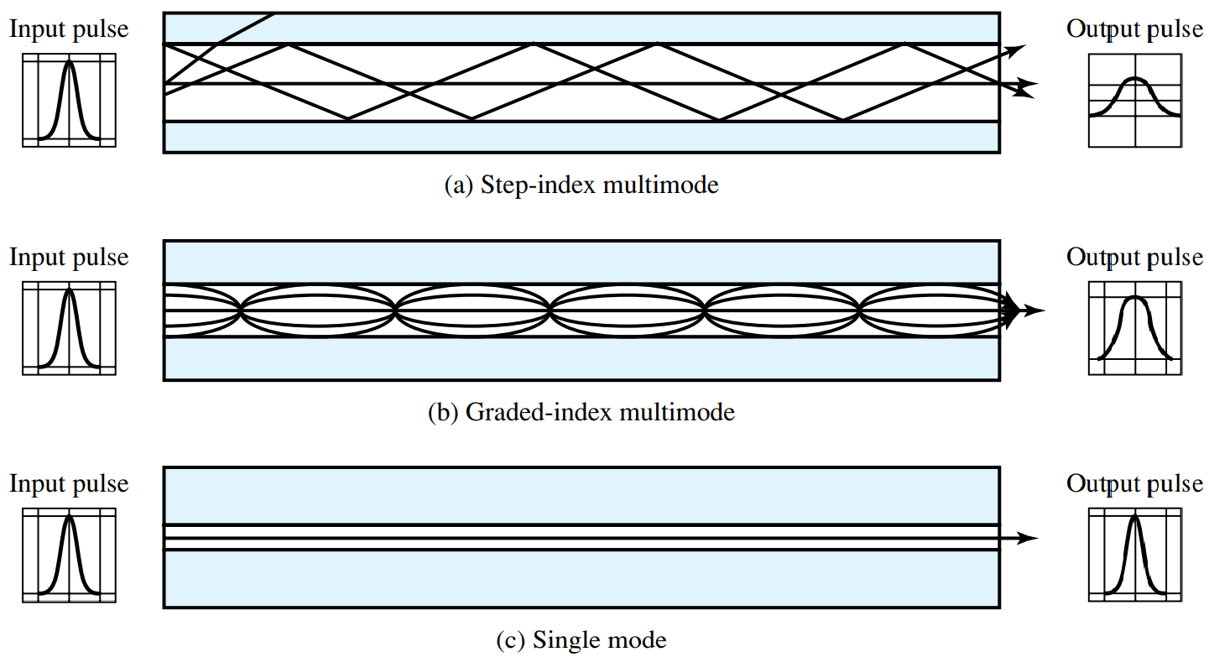
Optical Fiber Transmission Modes
Notes:
In this discuss I am going to discuss a number of adaptive routing challenges in wireless multi-hop networks. The routing issues that I have addressed are tied with other distributed algorithms such as channel selection and power control. I have addressed these challenges in two domains of wireless networks, 1. WOBAN and 2. WSNs.
I will first talk about the basic architecture of WOBAN and describe the problem of routing and channel selection in this kind of architecture. We solve this problem in three phases. First we describe a quality aware routing for single gateway WOBAN. Then we extend this model for WOBAN with multiple gateways. Next we address the routing problem in WOBANs that are equipped with multiple wireless gateways and the wireless routers have multiple radio interfaces.
After that I will address the problem of energy aware routing in data collection WSNs where enhancing the network lifetime is the major concern. We propose two ways to reduce the energy consumption in WSNS 1. by using multiple channels that gives rise to joint routing and channel selection in WSNs and another is through power control.

Slide 15
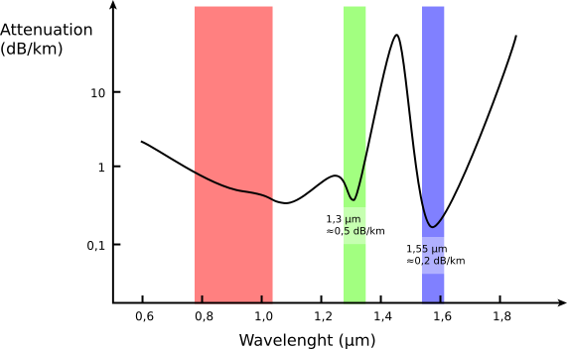
Optical Fiber Performance
Src: https://commons.wikimedia.org/wiki/File:Optical_fiber_transmission_windows.svg
Notes:
In this discuss I am going to discuss a number of adaptive routing challenges in wireless multi-hop networks. The routing issues that I have addressed are tied with other distributed algorithms such as channel selection and power control. I have addressed these challenges in two domains of wireless networks, 1. WOBAN and 2. WSNs.
I will first talk about the basic architecture of WOBAN and describe the problem of routing and channel selection in this kind of architecture. We solve this problem in three phases. First we describe a quality aware routing for single gateway WOBAN. Then we extend this model for WOBAN with multiple gateways. Next we address the routing problem in WOBANs that are equipped with multiple wireless gateways and the wireless routers have multiple radio interfaces.
After that I will address the problem of energy aware routing in data collection WSNs where enhancing the network lifetime is the major concern. We propose two ways to reduce the energy consumption in WSNS 1. by using multiple channels that gives rise to joint routing and channel selection in WSNs and another is through power control.

Slide 16
Attenuation Comparison
Notes:
In this discuss I am going to discuss a number of adaptive routing challenges in wireless multi-hop networks. The routing issues that I have addressed are tied with other distributed algorithms such as channel selection and power control. I have addressed these challenges in two domains of wireless networks, 1. WOBAN and 2. WSNs.
I will first talk about the basic architecture of WOBAN and describe the problem of routing and channel selection in this kind of architecture. We solve this problem in three phases. First we describe a quality aware routing for single gateway WOBAN. Then we extend this model for WOBAN with multiple gateways. Next we address the routing problem in WOBANs that are equipped with multiple wireless gateways and the wireless routers have multiple radio interfaces.
After that I will address the problem of energy aware routing in data collection WSNs where enhancing the network lifetime is the major concern. We propose two ways to reduce the energy consumption in WSNS 1. by using multiple channels that gives rise to joint routing and channel selection in WSNs and another is through power control.

Slide 17
Optical Fiber - Benefits
Greater capacity
Data rates of 100 Gbps+ (as compared to 1 Gps with electrical cables)
Smaller size and lighter weight
Considerably thinner than coaxial or twisted pair cable
Lower attenuation
Maximum distance is 40 km → as compared to 2 km (twisted pair) and 10 km (coaxial cable)
Greater repeater spacing
Lower cost and fewer sources of error
Electromagnetic isolation
Not vulnerable to interference, impulse noise, or crosstalk
High degree of security from eavesdropping
Notes:
In this discuss I am going to discuss a number of adaptive routing challenges in wireless multi-hop networks. The routing issues that I have addressed are tied with other distributed algorithms such as channel selection and power control. I have addressed these challenges in two domains of wireless networks, 1. WOBAN and 2. WSNs.
I will first talk about the basic architecture of WOBAN and describe the problem of routing and channel selection in this kind of architecture. We solve this problem in three phases. First we describe a quality aware routing for single gateway WOBAN. Then we extend this model for WOBAN with multiple gateways. Next we address the routing problem in WOBANs that are equipped with multiple wireless gateways and the wireless routers have multiple radio interfaces.
After that I will address the problem of energy aware routing in data collection WSNs where enhancing the network lifetime is the major concern. We propose two ways to reduce the energy consumption in WSNS 1. by using multiple channels that gives rise to joint routing and channel selection in WSNs and another is through power control.

Slide 18
Summary
Wired transmission medium:
Twisted pair cable
Coaxial cable
Optical fiber

